Slide 1
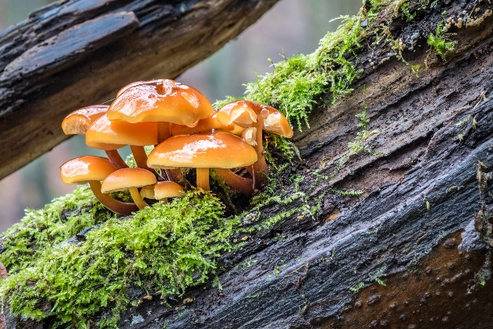
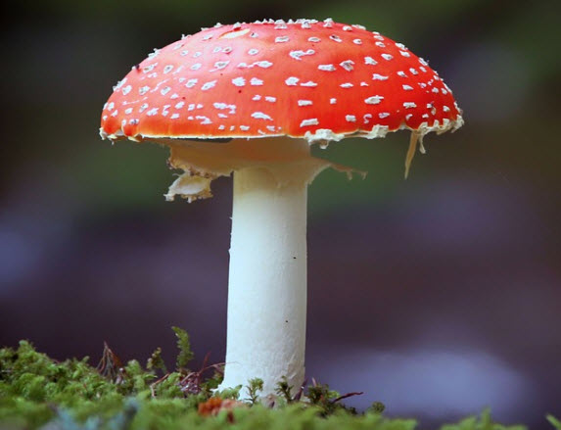
Exercise 1: Mushrooms

Slide 2
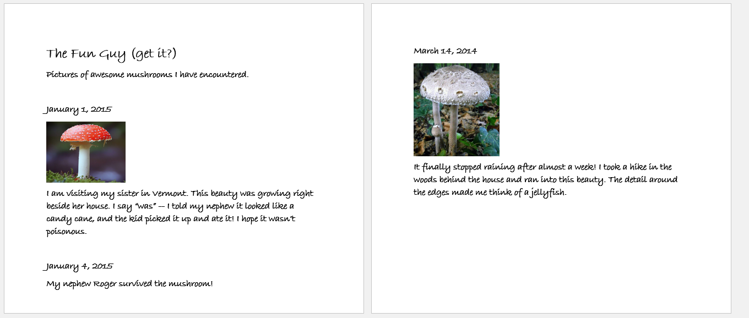
Exercise 1: Mushrooms
https://github.com/topherCantrell/class-HTMLCSS/tree/master/Exercise1

Slide 3
Exercise 1: Mushrooms
Jacob is fascinated by mushrooms! You can see the first two pages of his photo journal above. In this exercise you will convert his written journal into a single HTML page.
Make a rough paper sketch of your design.
Decide how the parts of the journal map to HTML elements.
Use the images in the project directory.
Add other images and entries to Jacob’s web journal!

